Slide 1
Deep learning in population genetics and multi-omics
Julie Hussin
February 14, 2020

Slide 2
Multi-omics Variation in Biomedical Sciences

Slide 3
Functional Genomics
Assigning function at the near-nucleotide resolution
Hi-C
Methylome
Modified from A User's Guide to the Encyclopedia of DNA Elements (ENCODE) in PLoS Biology.

Slide 4
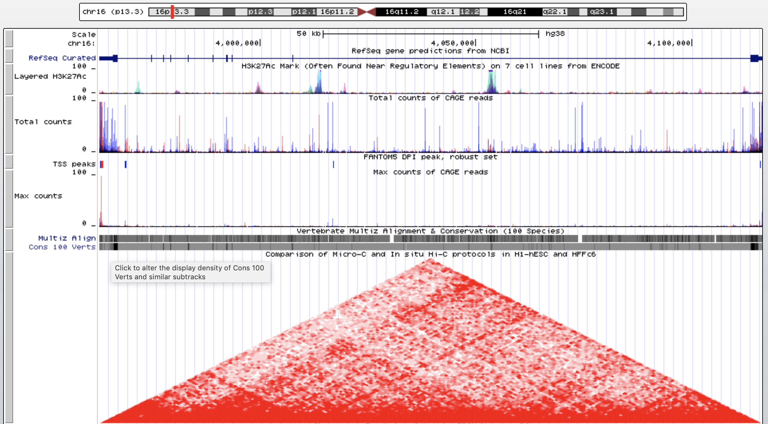
Functional Genomics
Assigning function at the near-nucleotide resolution
Genomic annotation
Hi-C
Methylome
Modified from A User's Guide to the Encyclopedia of DNA Elements (ENCODE) in PLoS Biology.

Slide 5
Interpreting non-coding genomic variants
Conservation scores : CADD
60 functional prediction tools
Most assume regulatory elements all have evolutionary constraints (true for protein-coding but not for non-coding)
GWAVA
Random Forest classifier using variant-specific annotations
Discriminate non-coding variants likely to be involved in disease from benign
Trained with the Human Gene Mutation database vs known common variants (3 control sets)
Could be applied to prioritize candidate functional variants
Not so good when genomic context is controlled for
Notes:
Ritchie, G. R. S., Dunham, I., Zeggini, E., & Flicek, P. (2014). Functional annotation of noncoding sequence variants. Nature Methods, 11(3), 294–296.doi:10.1038/nmeth.2832

Slide 6
Interpreting non-coding genomic variants
Conservation scores : CADD
60 functional prediction tools
Most assume regulatory elements all have evolutionary constraints (true for protein-coding but not for non-coding)
GWAVA (Richie et al. 2014)
Random Forest classifier using variant-specific annotations
Discriminate non-coding variants likely to be involved in disease from benign
Trained with the Human Gene Mutation database vs known common variants (3 control sets)
Could be applied to prioritize candidate functional variants
Not so good when genomic context is controlled for
Notes:
Ritchie, G. R. S., Dunham, I., Zeggini, E., & Flicek, P. (2014). Functional annotation of noncoding sequence variants. Nature Methods, 11(3), 294–296.doi:10.1038/nmeth.2832

Slide 7
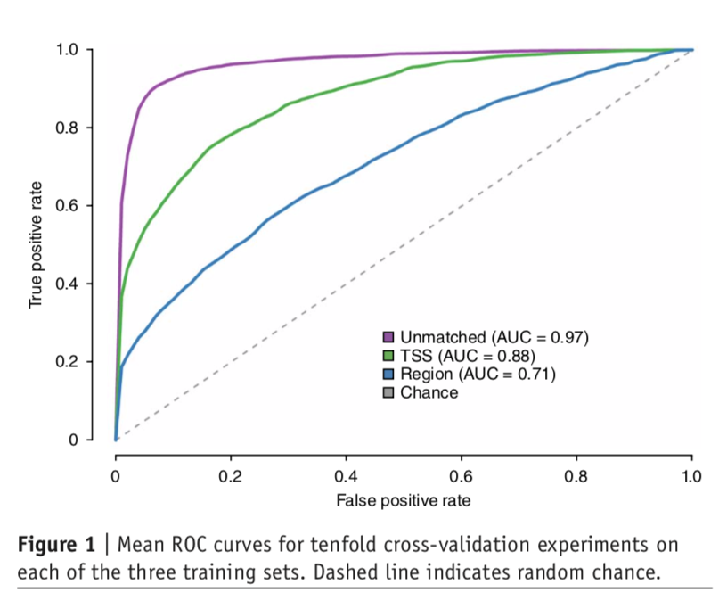
Interpreting non-coding genomic variants
Conservation scores : CADD
60 functional prediction tools
Most assume regulatory elements all have evolutionary constraints (true for protein-coding but not for non-coding)
GWAVA (Richie et al. 2014)
Random Forest classifier using variant-specific annotations
Discriminate non-coding variants likely to be involved in disease from benign
Trained with the Human Gene Mutation database vs known common variants (3 control sets)
Could be applied to prioritize candidate functional variants
Not so good when genomic context is controlled for
Notes:
Ritchie, G. R. S., Dunham, I., Zeggini, E., & Flicek, P. (2014). Functional annotation of noncoding sequence variants. Nature Methods, 11(3), 294–296.doi:10.1038/nmeth.2832

Slide 8
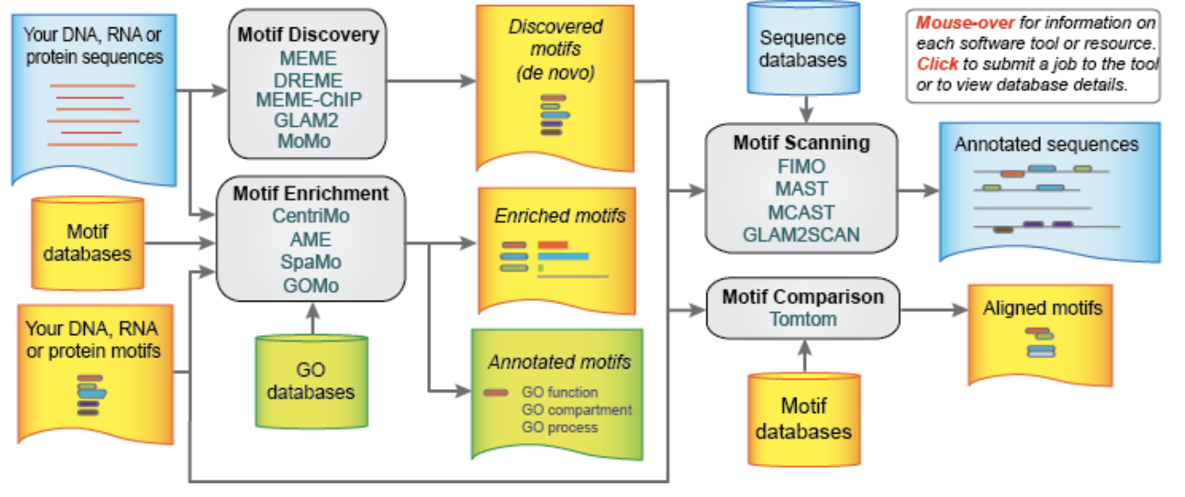
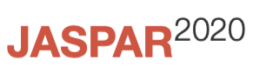
Interpreting non-coding genomic variants
Motif database and Motif search (JASPAR, MEME suite)
A motif is a sequence pattern that occurs repeatedly in a group of related DNA/protein sequences
Often associated with some biological function
Needs prior knowledge/hypothesis
MEME suite
Notes:
Ritchie, G. R. S., Dunham, I., Zeggini, E., & Flicek, P. (2014). Functional annotation of noncoding sequence variants. Nature Methods, 11(3), 294–296.doi:10.1038/nmeth.2832

Slide 9
Functional Genomics
Assigning function at the near-nucleotide resolution
Massive datasets!!!
Hi-C
Methylome
Eg. ENCODE
Modified from A User's Guide to the Encyclopedia of DNA Elements (ENCODE) in PLoS Biology.
Notes:
The functional genomics high-throughput sequencing data generated by the ENCODE project (18) and the NIH Roadmap Epigenomics project (19) facilitates the systematic annotation of TF binding profiles, which makes it possible to identify cell type-specific regulatory elements and to study the TF binding intensities to various DNA sequences. The high-throughput chromosome conformation capture sequencing data helps to uncover genome-wide chromatin organization and interactions (20), enabling the identification of target genes for distal regulatory elements.

Slide 10
Deep learning in functional genomics
Capability to automatically discover predictive signatures
Can handle high-dimensional data
Examples :
DeepBind
DeepSEA
Basset
DanQ
Basenji (BioRxiv: https://doi.org/10.1101/161851)
DeFine
Annotation: modify your input sequence to add variant and see how the prediction changes

Slide 11
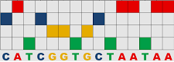
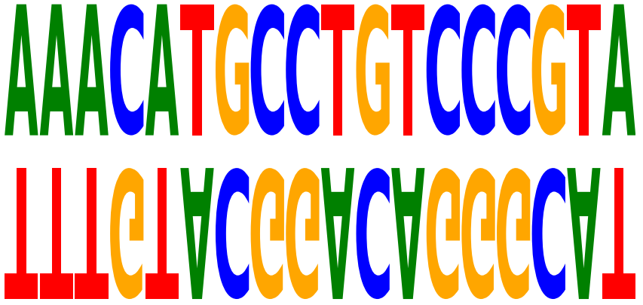
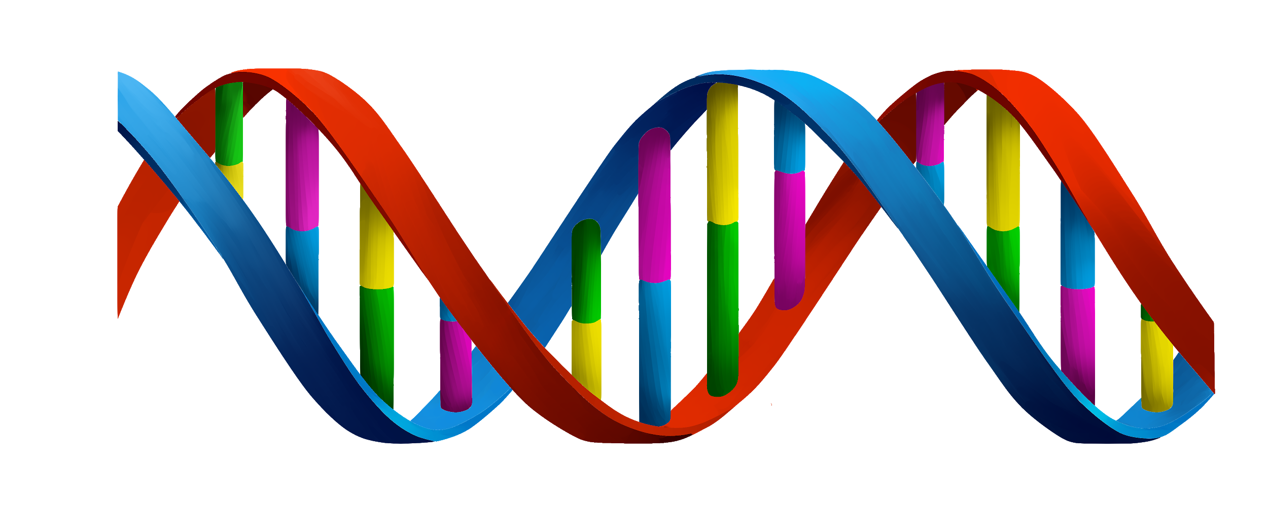
Feature representation
Feature representation allows for more efficient learned representation as in the case of embeddings, as well as transforming the data modality as in the case of one-hot-encoding the nucleotide sequence.
Embeddings allow DNA sequences to be represented in a latent vector space [5] [6]
One hot encoding sequences allows CNN architectures to be applied to genomic sequences
Taking advantage explicitly of known biological insights into the representation.
For example, sequences and their reverse complement outperforms feeding the sequence in one direction alone[7]

Slide 12
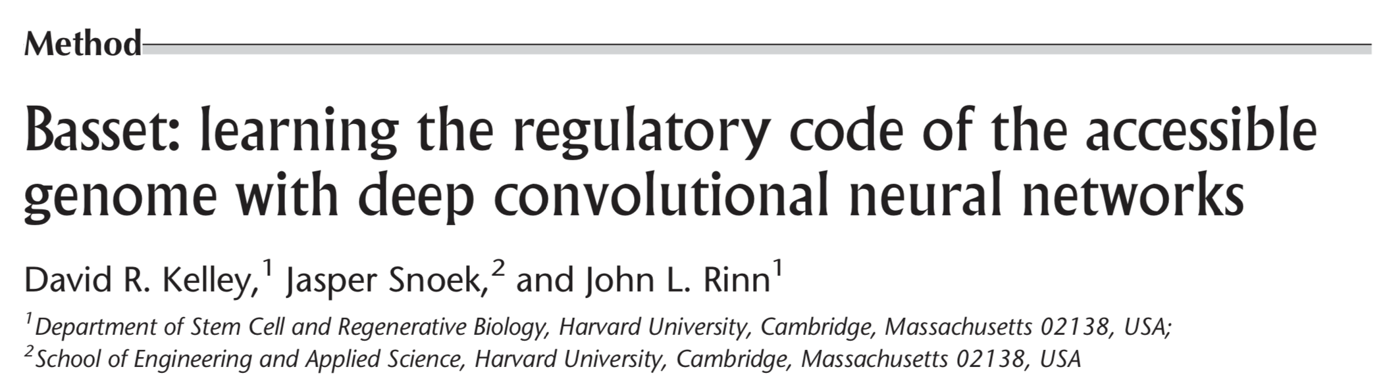
Basset
Deep CNNs to predict genome accessibility
Accessibility of DNA sequences is mapped by DNase-seq
Done in 164 cell types by the ENCODE Project Consortium and Roadmap Epigenomics Consortium
The network learns:
relevant sequence motifs
regulatory logic to allow cell-specific predictions
Assignment of cell-specific scores to candidate variants that reflect accessibility difference predicted by the model between the two alleles

Slide 13
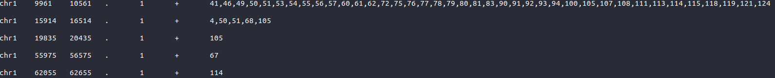
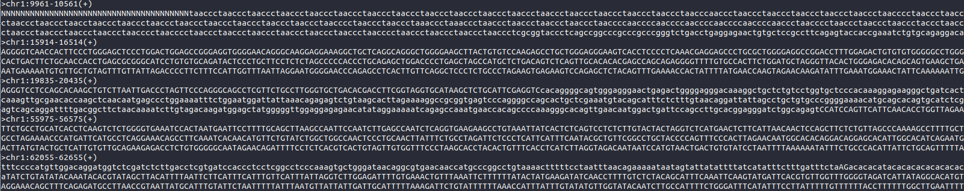
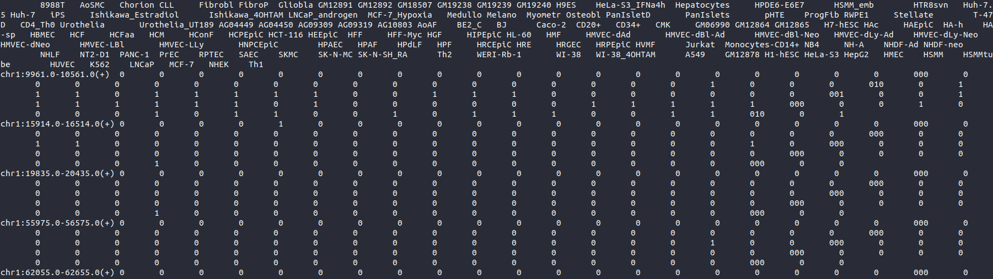
13
Emad Takla
Notes:
2/14/20
13
13

Slide 14
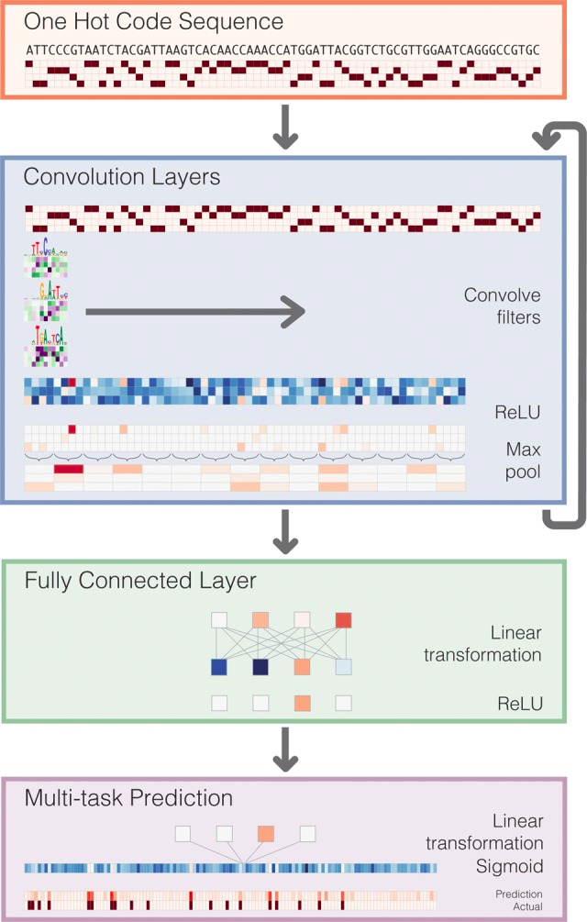
Basset
Input
300 Convolutions Filters, width = 19
Pooling Layer = 3
200 Convolutions Filters, width = 11
Pooling Layer = 4
200 Convolutions Filters, width = 7
Pooling Layer = 4
Fully Connected = 1000 neuron
Dropout = 0.3
Fully Connected = 1000 neuron
Dropout = 0.3
Output (164 Outputs are independent, using independent sigmoids and not a Soft max)

Slide 15
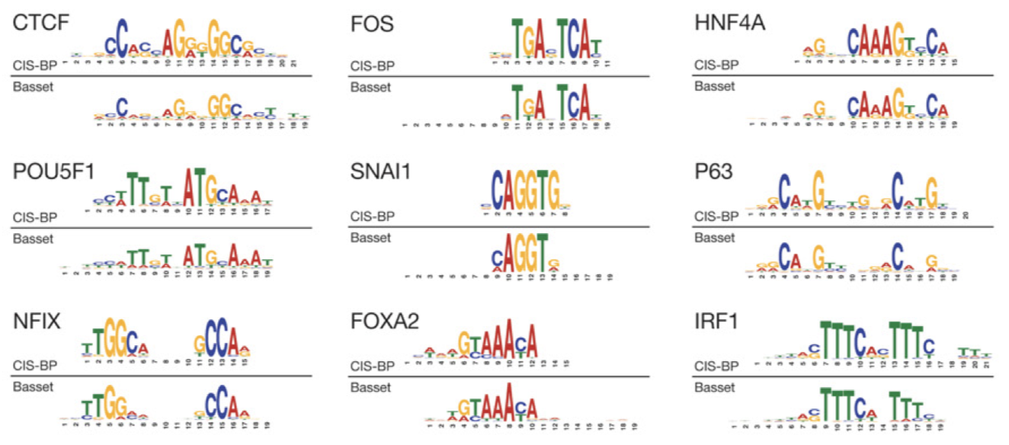
Basset
The initial convolution layer corresponds to optimizing the weights of a set of PWMs. PWM filters search for their motifs along the sequence
Subsequent convolutional layers operate analogously on the output of the prior layer.
Learns sophisticated regulatory codes that combine the recognized sequence motifs

Slide 16
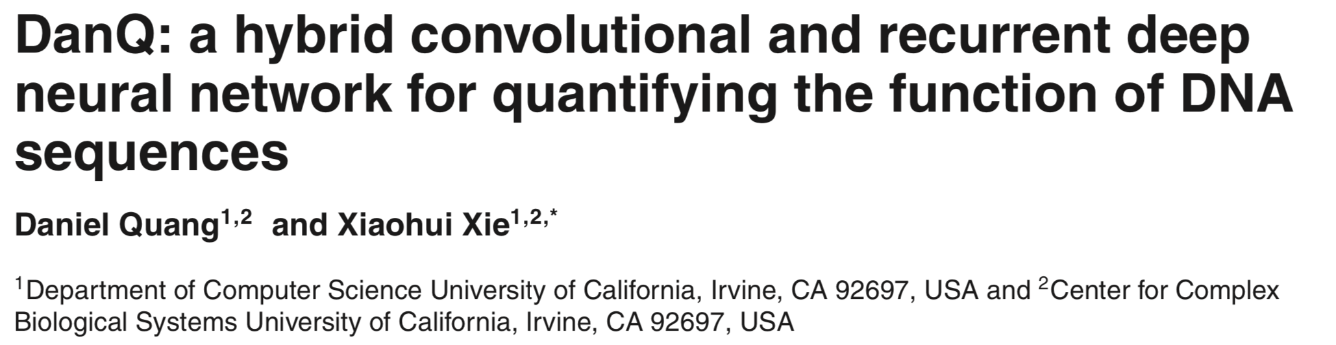
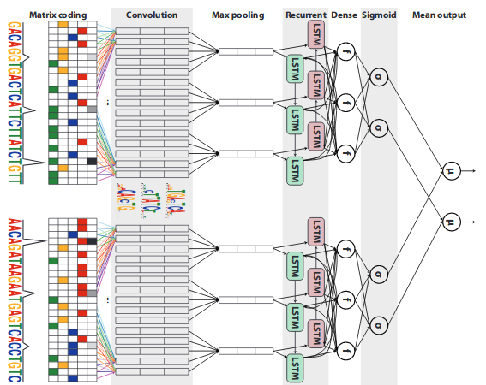
DANQ
Hybrid CNN/RNN
CNN filters act like position-weight matrix motif scanners.
Recurrent models are better suited for sequence-based tasks.
Hybrid CNN/RNN architecture allows taking advantage of both capabilities of these architectures.
The resulting models had always outperformed models that have used either architectures alone.
Hybrid architecture with the nucleotides sequence and its reverse complement as an input

Slide 17
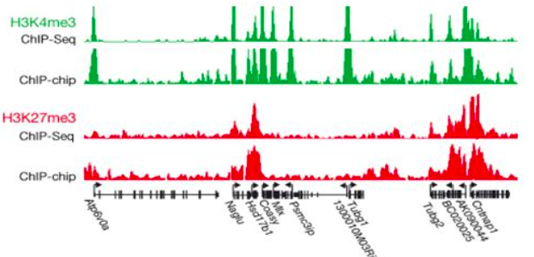
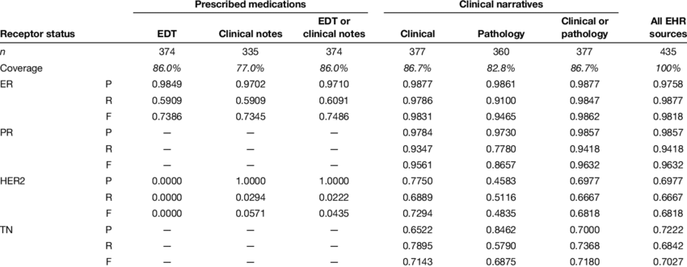
Multitask and Multimodal Learning
Output
Input 1 (image-like)
Input 2
(Numeric series)
Input 3
(Tabular)
Multimodal learning can learn a shared representation between modalities.
Shown in non-biological problems to increase a neural network’s performance
Notes:
Multitask deep learning is creating a deep neural network predicting multiple independent tasks. Multimodal learning was shown in non-biological problems to increase a neural network’s performance. One hypothesis for that is that such tasks forces the network to learn the shared relevant information for the tasks from all modals, biasing the network to learn more relevant features and lower the effect of the noise carried by the different input signals[9].

Slide 18
Multitask and Multimodal Learning
Output
Output 1
(e.g. cell line 1)
Output 2
(e.g. cell line 2)
Output 3
(e.g. cell line 3)
Output 4
(e.g. cell line 4)
Output 5
(e.g. cell line 5)
Input 1 (image-like)
Input 2
(Numeric series)
Input 3
(Tabular)
Multimodal learning can learn a shared representation between modalities.
Multitask learning is using the same input into predicting different tasks.
Basset network was an early successful example of multi-task approach in genomics.
Shown in non-biological problems to increase a neural network’s performance
Notes:
Multitask deep learning is creating a deep neural network predicting multiple independent tasks. Multimodal learning was shown in non-biological problems to increase a neural network’s performance. One hypothesis for that is that such tasks forces the network to learn the shared relevant information for the tasks from all modals, biasing the network to learn more relevant features and lower the effect of the noise carried by the different input signals[9].

Slide 19
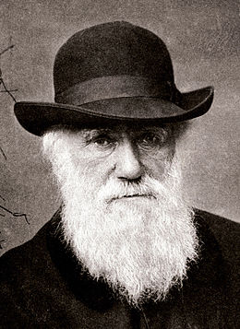
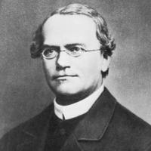
Population Genetics
Emerged from early efforts to reconcile Mendelian genetics with evolution
Charles Darwin
1809-1882
Gregor Mendel
1822-1884
Notes:
rules of Mendelian genetics are nearly universal across diploids:
genome of an individual is formed from two gametes that fused to form a zygote. The genomes of each gamete originate from a parental genome through meiosis, in particular the segregation and recombination of the parental genome’s two gametes.
Particulate model:
Offspring are a combination of both parents
The characteristics of both parents are passed on to the next generation as separate entities
Variation is maintained over time

Slide 20
Population Genetics
Population genetics is the study of how the genetic composition of natural populations has changed over successive generations.
The driving forces of biological evolution are:
Mutation
Structure
Genetic drift
Selection
Migration
Recombination

Slide 21
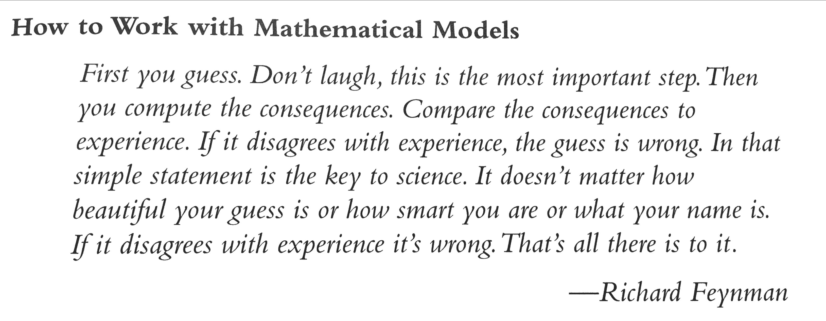
Classical approaches: Mathematical models
Mathematical representation of a biological process to do inference
Give a set of “expected values” through equations
Parameters : constants in equation we specify or estimate
Notes:
Students are generally skeptical of mathematical models and resist them
What do you want to know
Biological assumptions
Express assumption and question in equations, define symbols
Solve
Analyse the prediction
Compare to reality
If do not match return to step 2 and modify assumptions

Slide 22
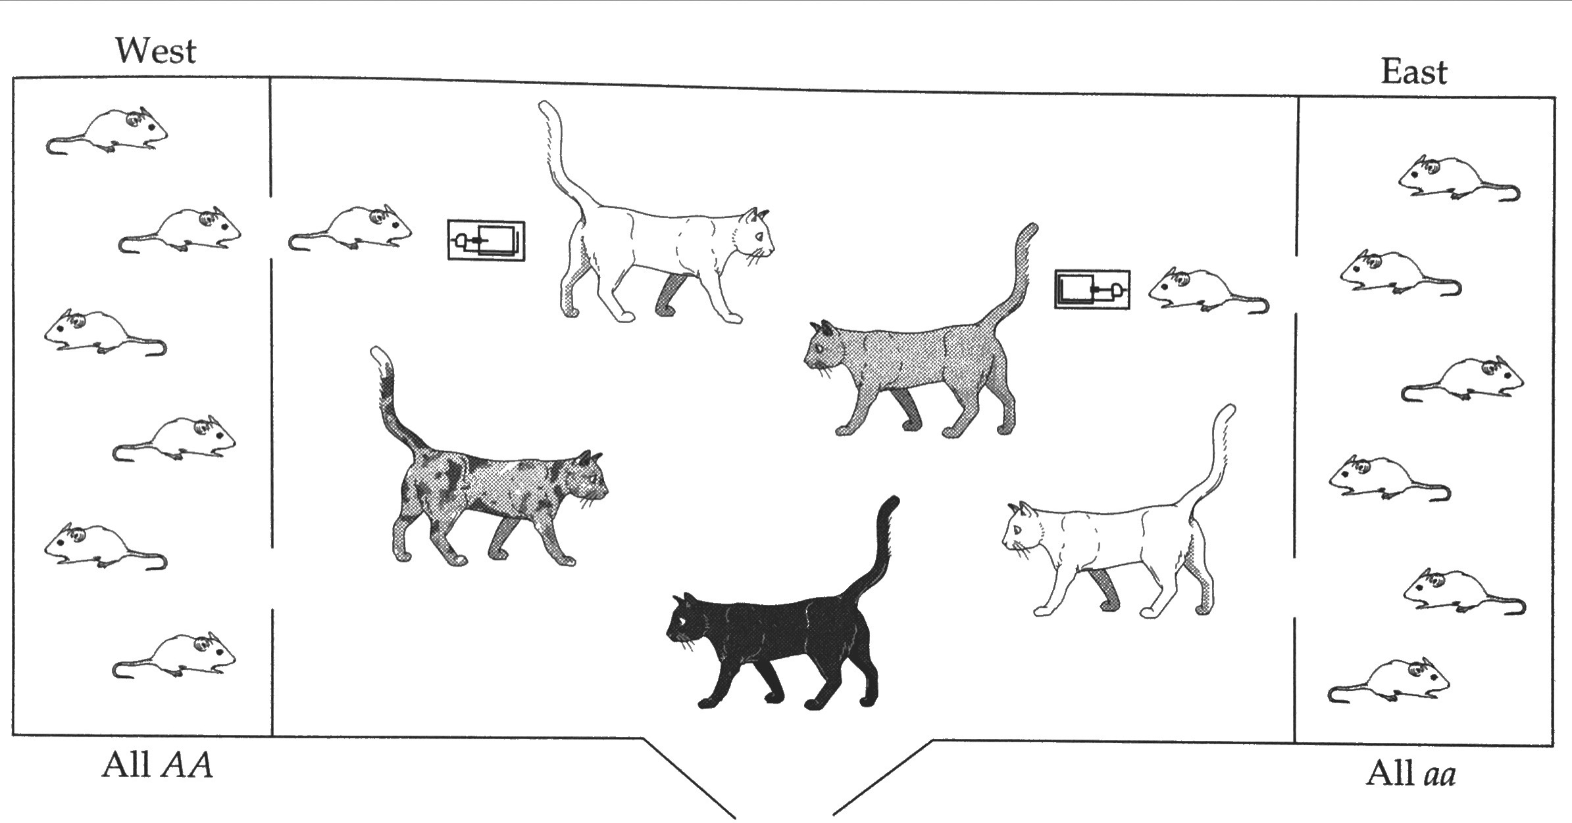
Population Structure
Extreme example for a locus with 2 alleles:
A (frequency p)
a (frequency q)
f(AA) = 0.5
f(aa) = 0.5
f(Aa) = 0
…When expected genotype frequency is 2pq (0.25)
From Hartl and Clark, Principles of Population Genetics, Third Edition, Figure 4.1
Notes:
of deficiency of heterozygotes
Problem 4.3

Slide 23
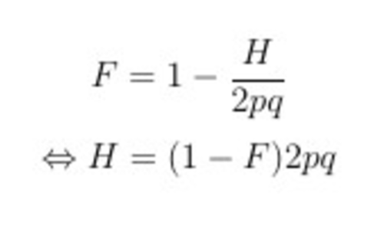
Population Structure
Extreme example for a locus with 2 alleles:
A (frequency p)
a (frequency q)
Wright’s F statistic measures the deviation of proportion of heterozygous Aa (H) from the 2pq expected.
f(AA) = 0.5
f(aa) = 0.5
f(Aa) = 0
…When expected genotype frequency is 2pq (0.5)
Notes:
of deficiency of heterozygotes
Problem 4.3

Slide 24
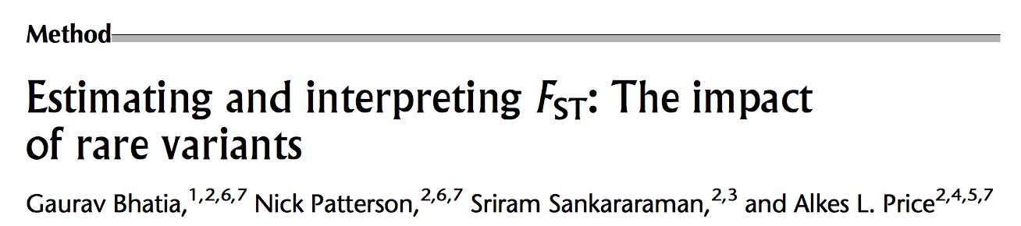

Slide 25
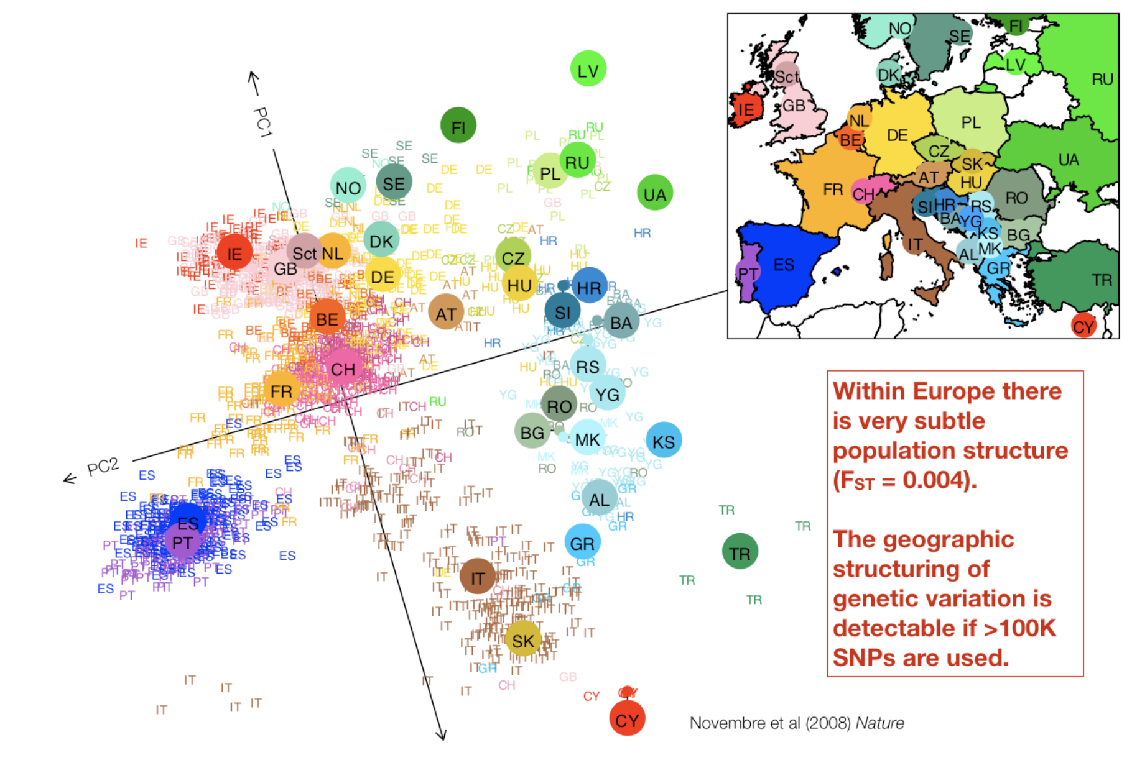
Principal Component Analyses
Principal components analysis of SNP data uncovers the major axes of genotype variance in our sample.
Notes:
with the first PC being that which explains most, the second the second most, and so on

Slide 26
Uniform Manifold Approximation and Projection (UMAP)
https://macarthurlab.org/2018/10/17/gnomad-v2-1/

Slide 27
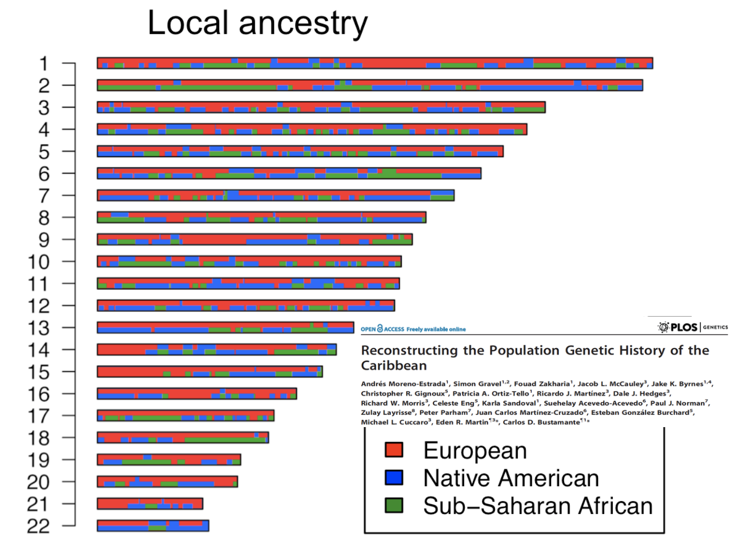
Local Ancestry
Caribbean Individual

Slide 28
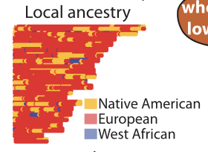
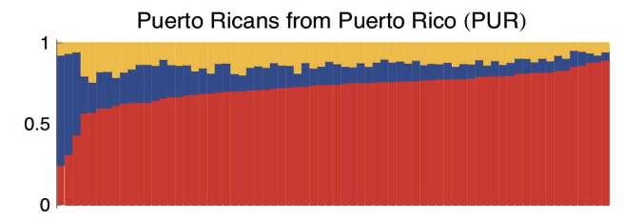
RFMix: Random Forest and Local Ancestry
B. K. Maples et al., Rfmix: a discriminative modeling approach for rapid and robust local-ancestry inference, American journal of human genetics 93 (2013) 278–288.

Slide 29
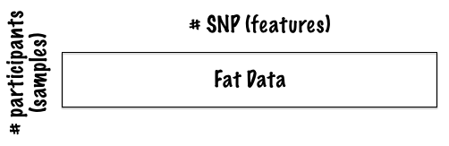
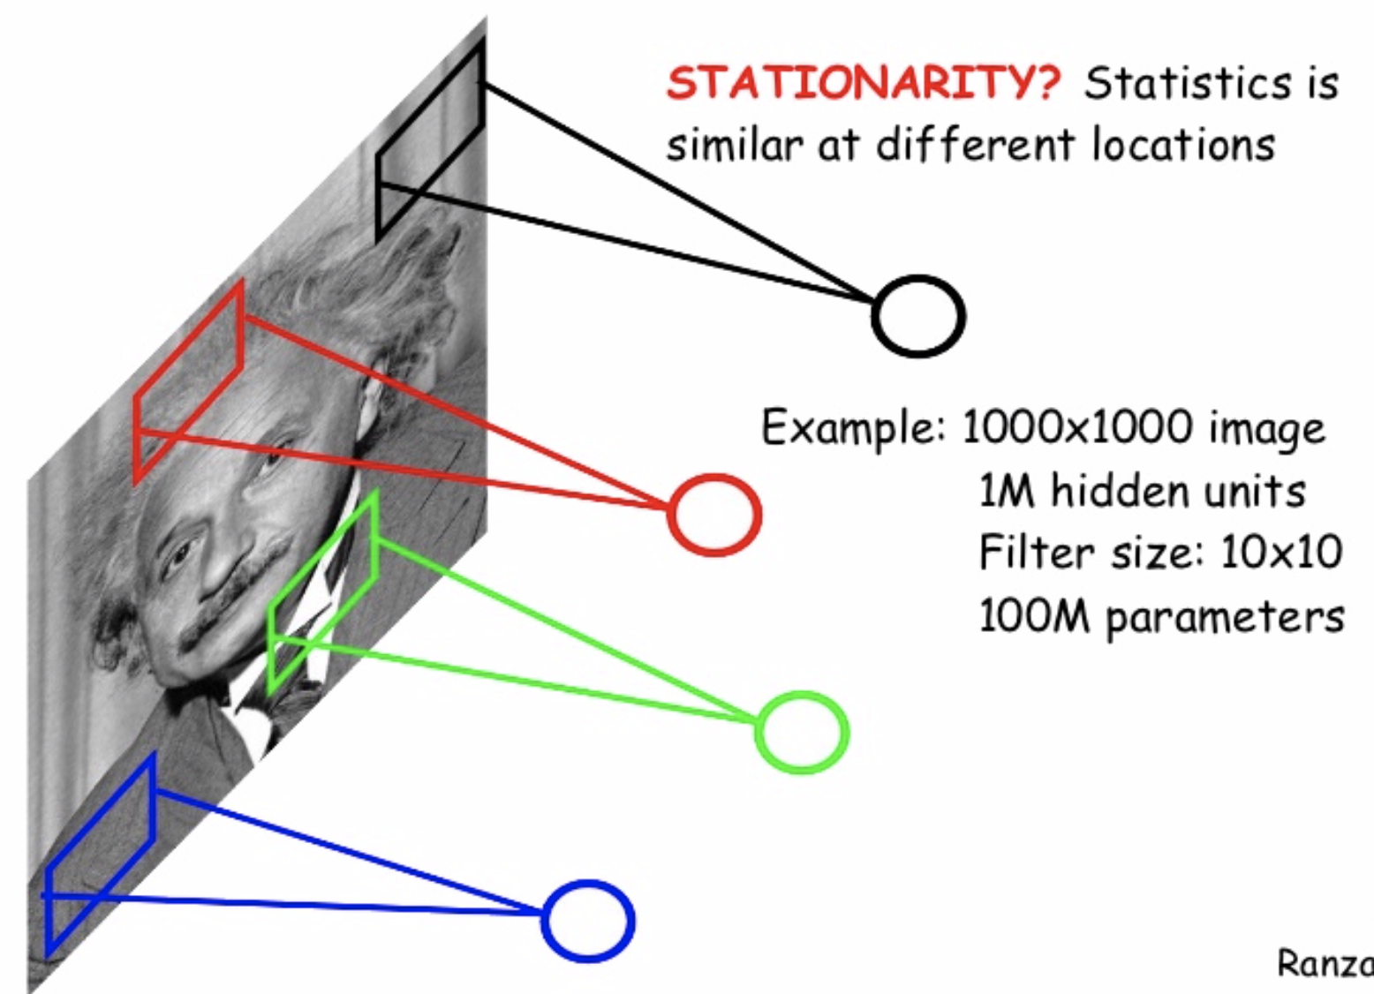
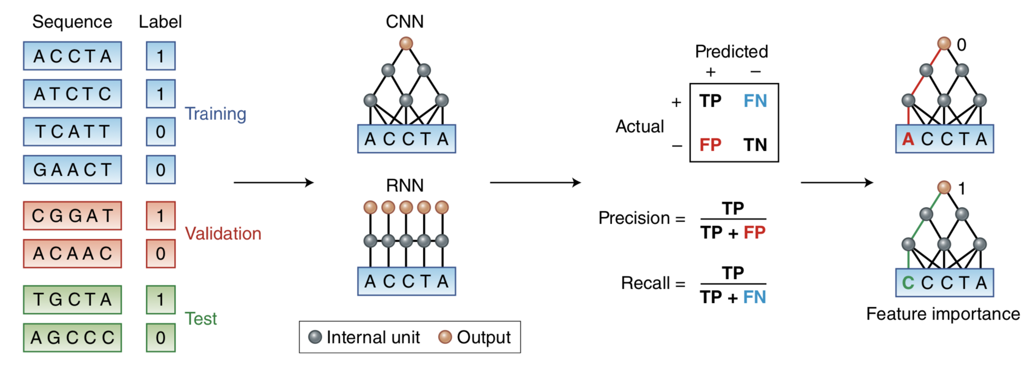
Deep learning for population structure?
CNN/RNN do not solve the problem of prediction from individual level genomics data (violate stationarity)

Slide 30





Diet networks: Thin Parameters for Fat Genomics
Input data:
NxF,
N << F
MLP
MLP
100
Yoshua Bengio
30M
300K
Input = 1 sample
1xF
Romero et al. ICLR 2017

Slide 31
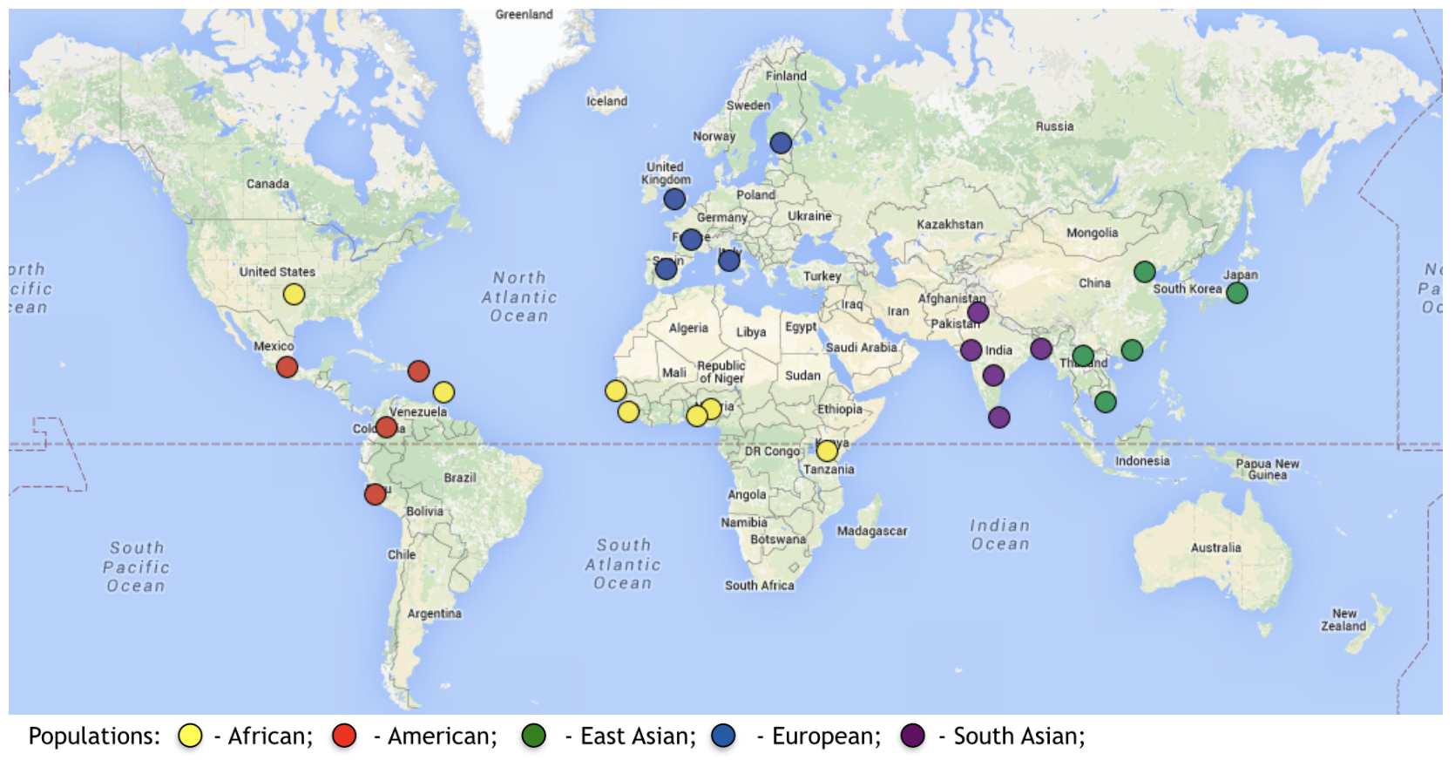
Population stratification of 1000 Genomes populations
The International Genome Sample Resource (IGSR)
The dataset includes 26 populations from 5 geographical regions, in total 3450 individuals.
We used 294,427 SNPs pruned autosomal SNPs (MAF>0.05) genotyped on Affy 6.0 array.

Slide 32
Population stratification of 1000 Genomes populations
YRI – Yoruba (Nigeria)
LWK – Luhya (Kenya)
GWD – Gambian (Gambia)
MSL – Mende (Sierra Leone)
ESN – Esan (Nigeria)
AFR
IBS – Iberian (Spain)
TSI – Toscani (Italia)
FIN – Finnish (Finland)
GBR – British (England and Scotland)
CEU – Utah Residents of EUR ancestry
EUR
Non Admixed
JPT – Japanese (Tokyo)
KHV – Kinh (Vietnam)
CHB – Han Chinese (Beijing)
CHS – Southern Han Chinese
CDX – Chinese Dai (Xishuangbanna)
EAS
PJL – Punjabi (Pakistan)
BEB – Bengali (Bangladesh)
STU – Sri Lankan Tamil (UK)
ITU – Indian Telugu (UK)
GIH – Gujarati Indian (Houston, Texas)
SAS
ASW – African Americans from SW USA
ACB – African Caribbeans (Barbados)
PUR – Puerto Ricans (Puerto Rico)
CLM – Colombians (Colombia)
PEL – Peruvians (Lima)
MXL – Mexican ancestry (Los Angeles)
Admixed
Misclassification error (5 fold) = 4.35 % (+/- 0.49)

Slide 33
Population Genetics
Population genetics is the study of how the genetic composition of natural populations has changed over successive generations.
The driving forces of biological evolution are:
Mutation
Structure
Genetic drift
Selection
Migration
Recombination

Slide 34
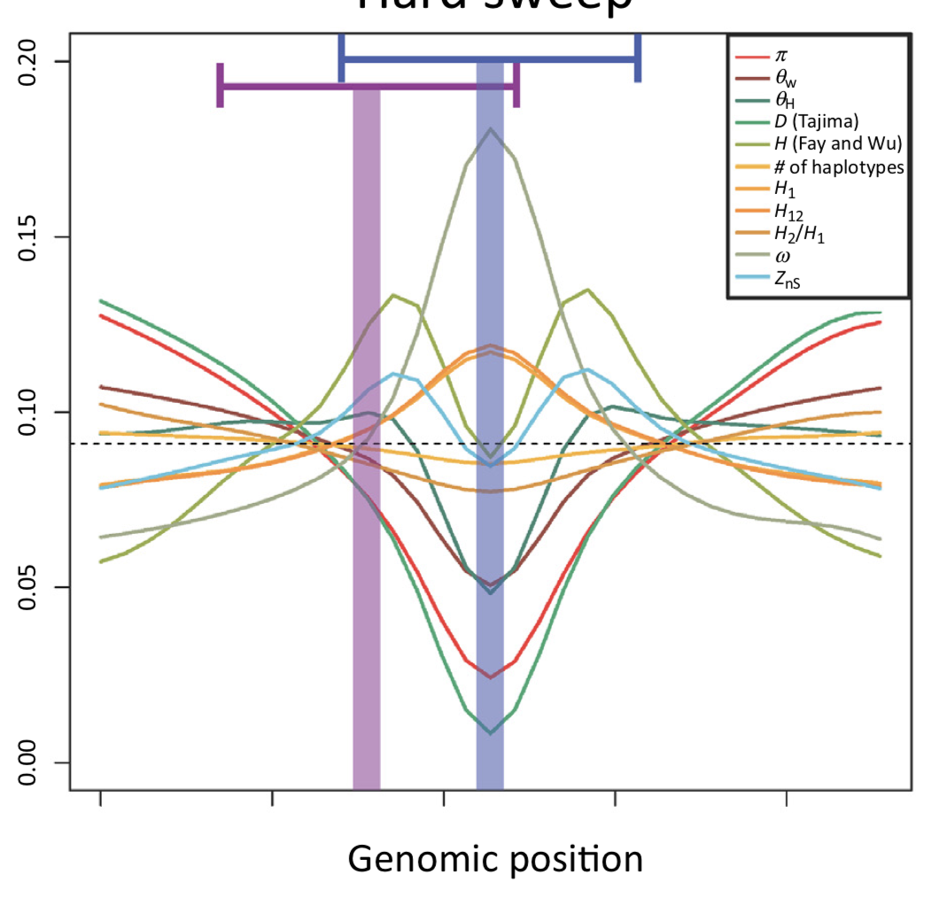
Natural selection
Summary statistics
Genetic variant under selection
Different signatures depending on population history (structure, population size)
Schrider and Kern, Trends in Genetics, April 2018, Vol. 34, No. 4

Slide 35
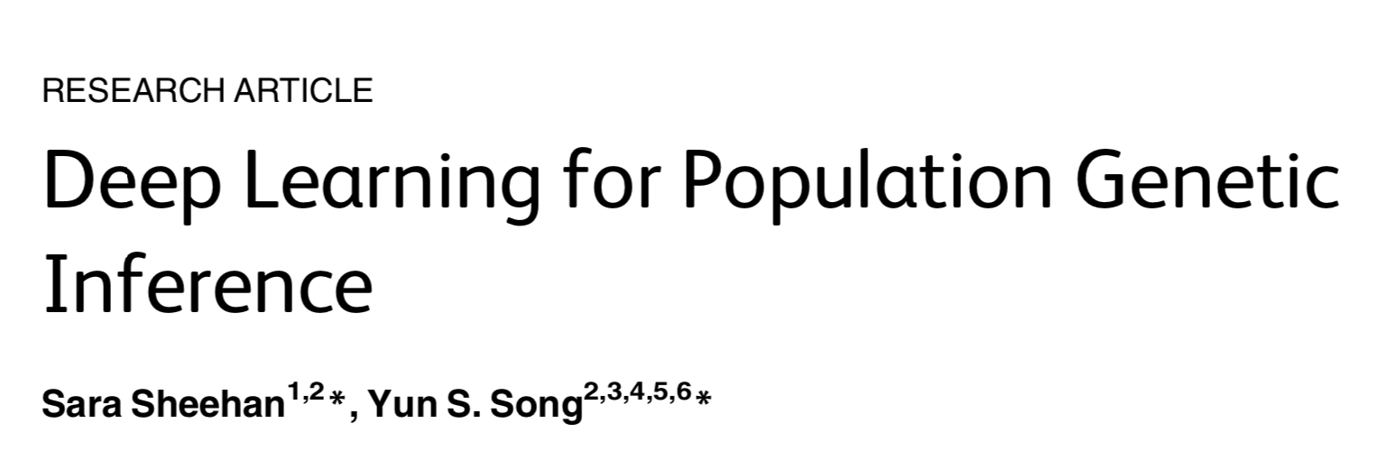
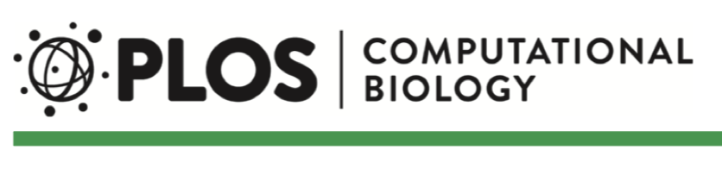
Population size and selection

Slide 36
Population size and selection
Simulations under different
scenarios
Computing Summary Statistics
Training/Testing
Demography only ~ 11h
Demography + selection ~ 75h
Real data??

Slide 37
Population Genetics
Population genetics is the study of how the genetic composition of natural populations has changed over successive generations.
The driving forces of biological evolution are:
Mutation
Structure
Genetic drift
Selection
Migration
Recombination

Slide 38
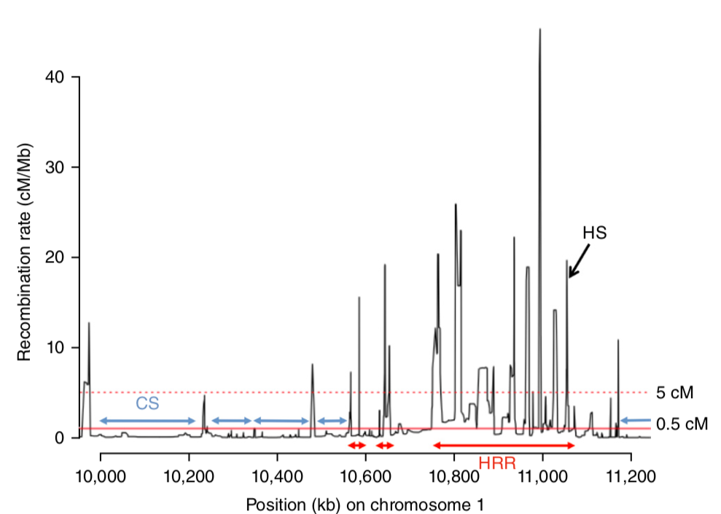
Recombination rates
Trickier to get summary statistics that are not confounded by selection/demography

Slide 39
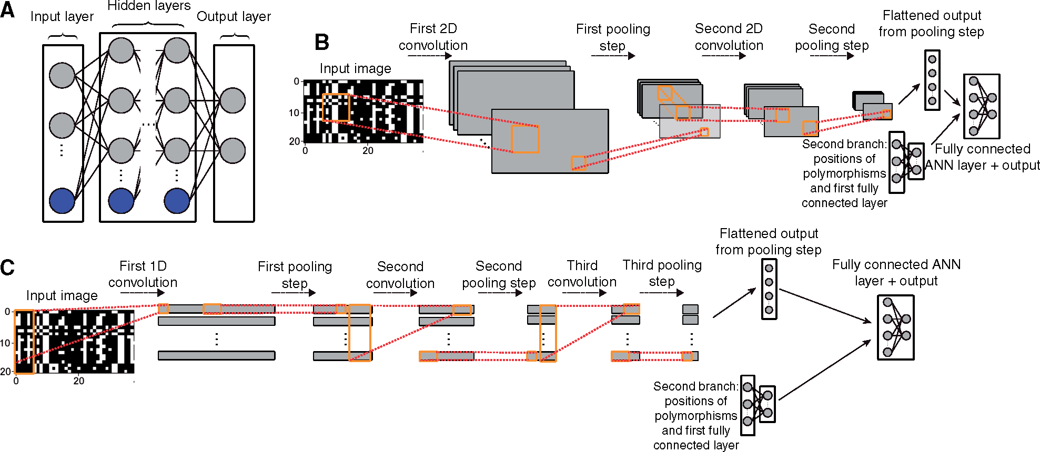
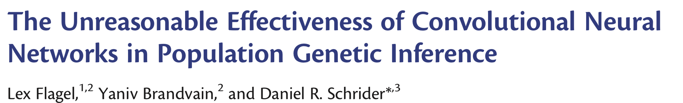

Recombination rates

Slide 40
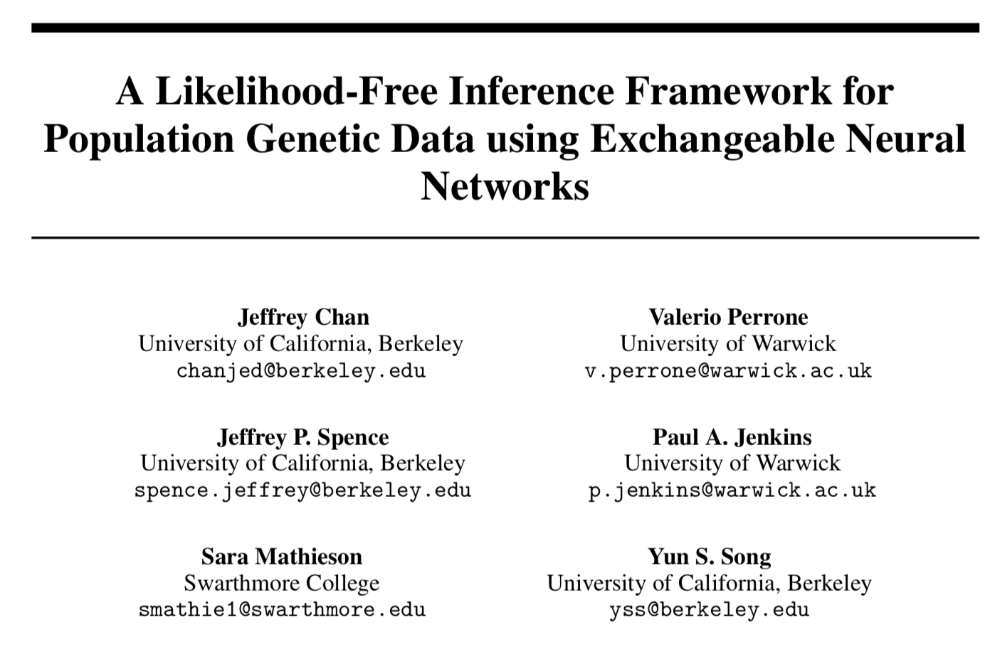
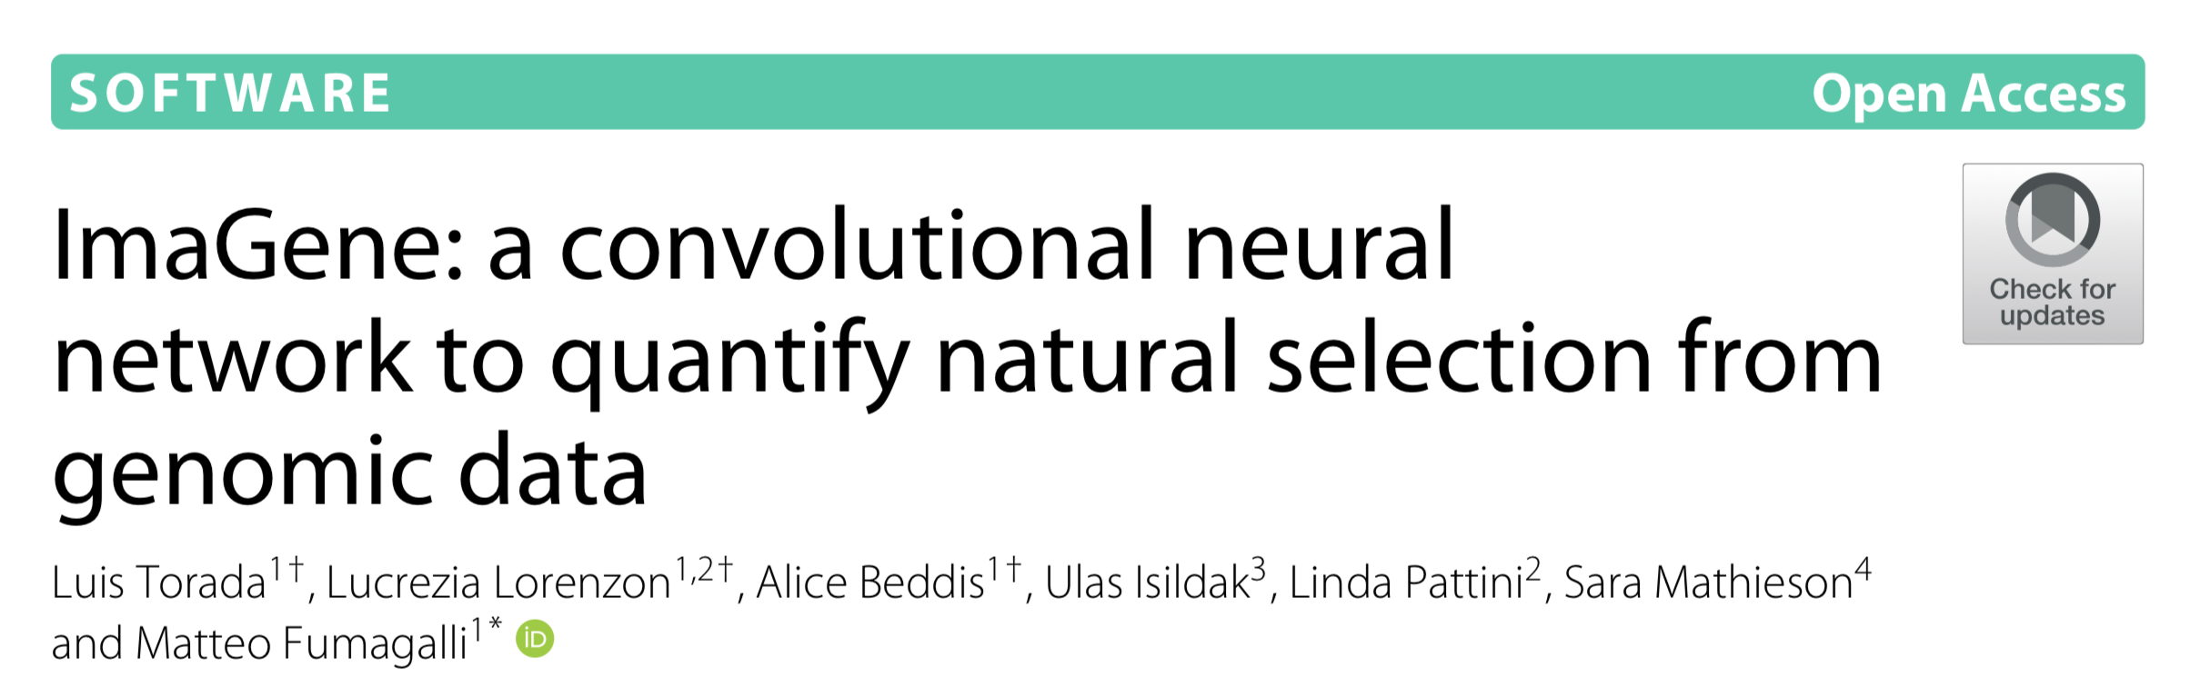
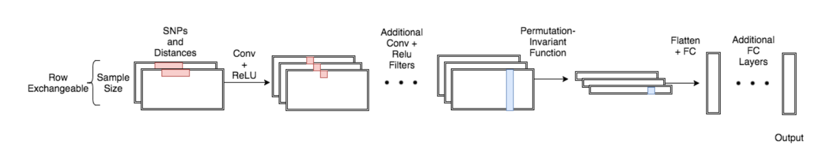
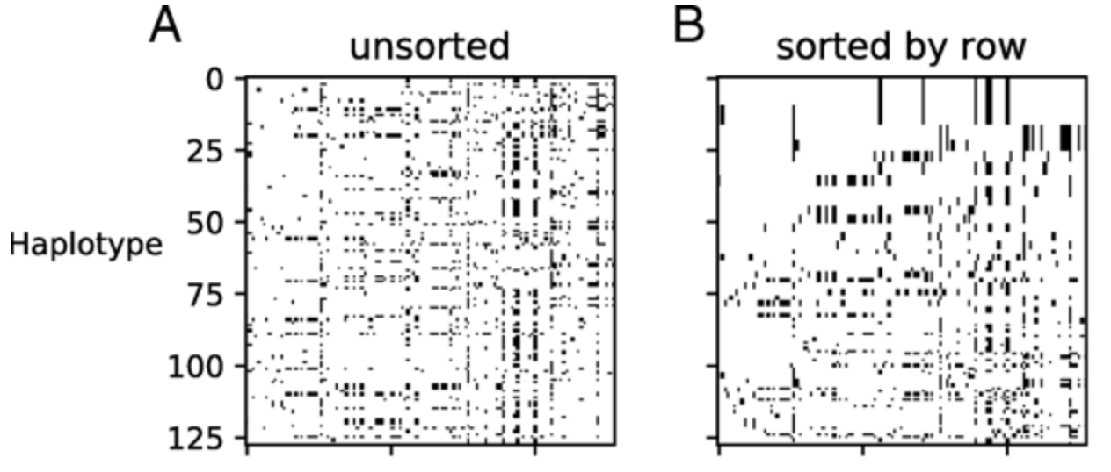
Additional work
Population genetics simulations: Aren’t we back to the model-based approaches?

Slide 42
Thank you!

Slide 44
Datasets
Dataset | Usefulness
ChIP-seq[2] | ChIP-seq assays uncover protein-DNA interaction.
RNA-seq[3] | RNA-seq provide a good insight over gene expression
Hi-C[4] | Hi-C data provides an estimate of physical proximity of different DNA segments, hinting to potential interaction between these regions.
Genomic sequence | The sequence of the reference genome, the base descriptor of each region.
Genomic Annotation : These databases provide the known functionality of each part of the human genome.

